Slide 1
PAL CHAT BOT ASSISTANT

Slide 2
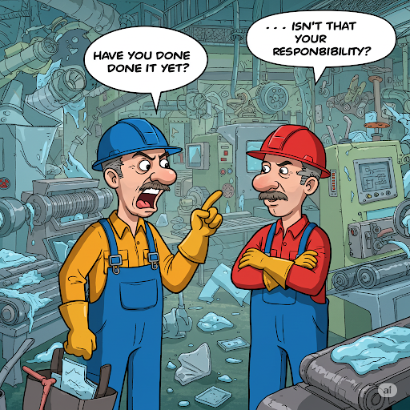
1. Presenting the problem
When receiving a sample in the lab, especially when the samples come in large quantities, there are many tasks that need to be carried out, requiring coordination between two people. However, in many cases, a lack of communication leads to frequent missed tasks, and it's not always convenient to communicate in real time. A better solution is needed for managing the required tasks.

Slide 3
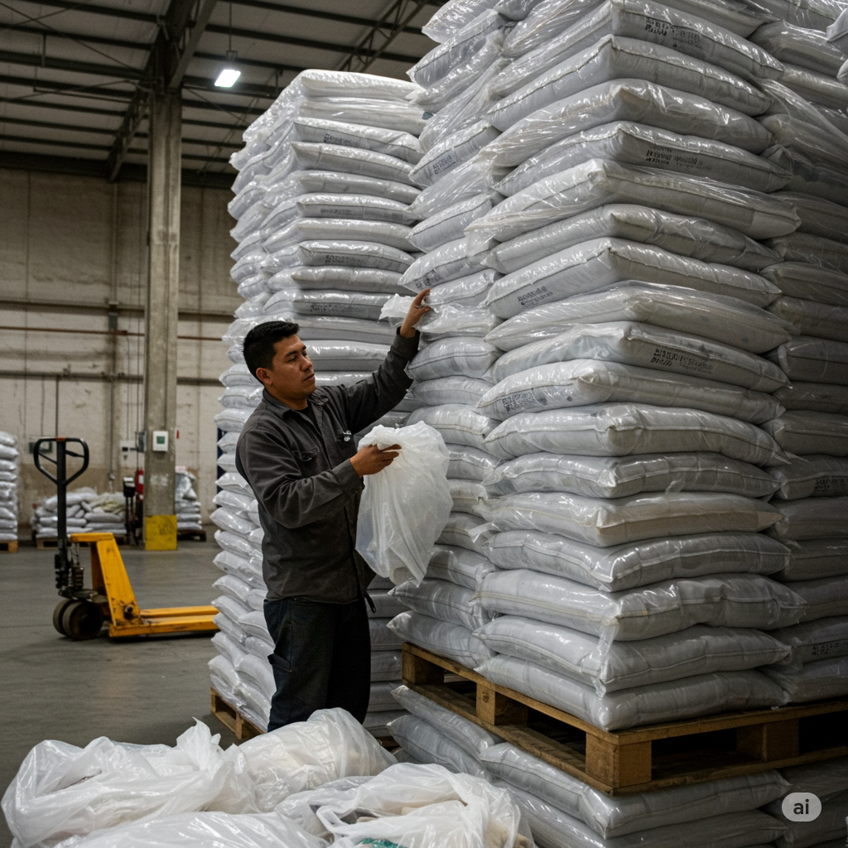
1. Presenting the problem
Another issue at PAL is the traditional method of storing retain samples, which takes a lot of time to search and does not guarantee that the sample can be found. Because the samples are stored in the traditional way, retrieving a retain sample each time requires a great deal of time and effort to sort through the plastic bags. Especially when the needed bag is located in the bottom layers, after moving all the plastic bags to reach the one at the bottom layer, you have to return all the previously moved bags back to their original positions.

Slide 4

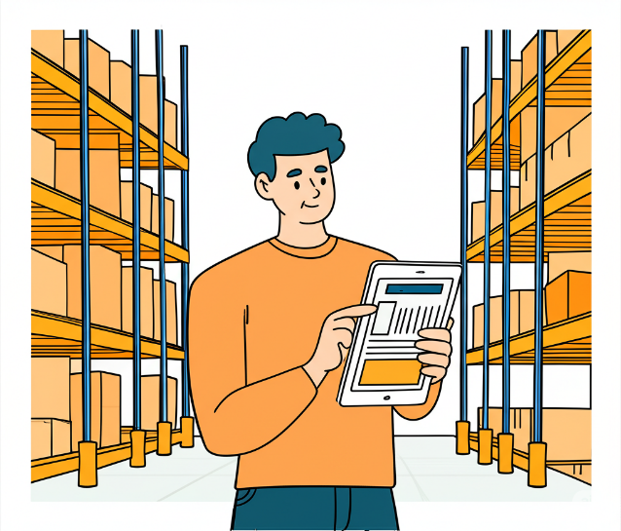
2. Finding the root causes
The main cause of these two issues is the lack of a proper workflow management system and the need to apply technology to storage processes instead of relying on traditional manual methods. Another point is that work management methods and storage approaches need to be customized to suit each specific area. Existing software solutions are not always the most effective way to address these issues.

Slide 5
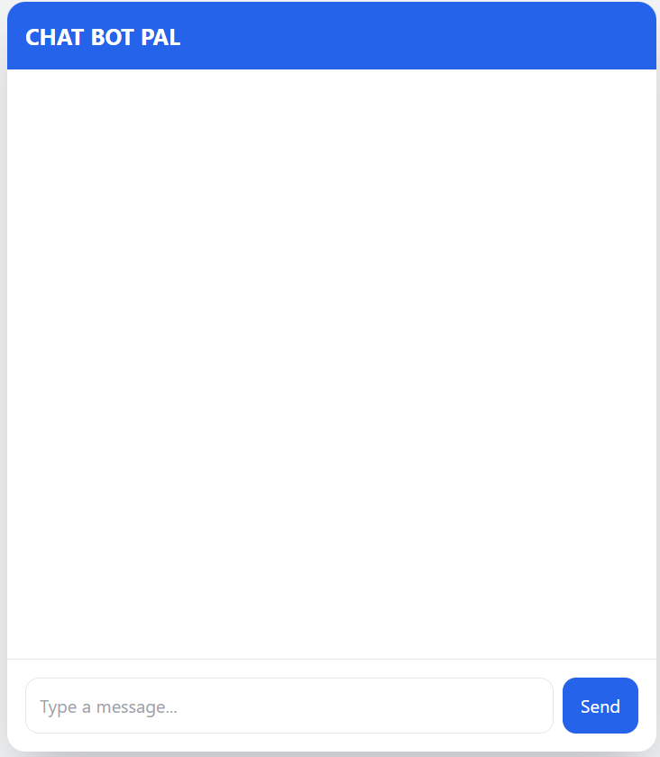
3. Finding the solutions
With all of that in mind, the solution I would like to propose here is a chatbot that functions as an assistant to help store, manage, and retrieve data. The chatbot was developed by me, using FastAPI for the backend, SQLModel for the database, and llama8B for natural language processing. All functions were written in Python.

Slide 6
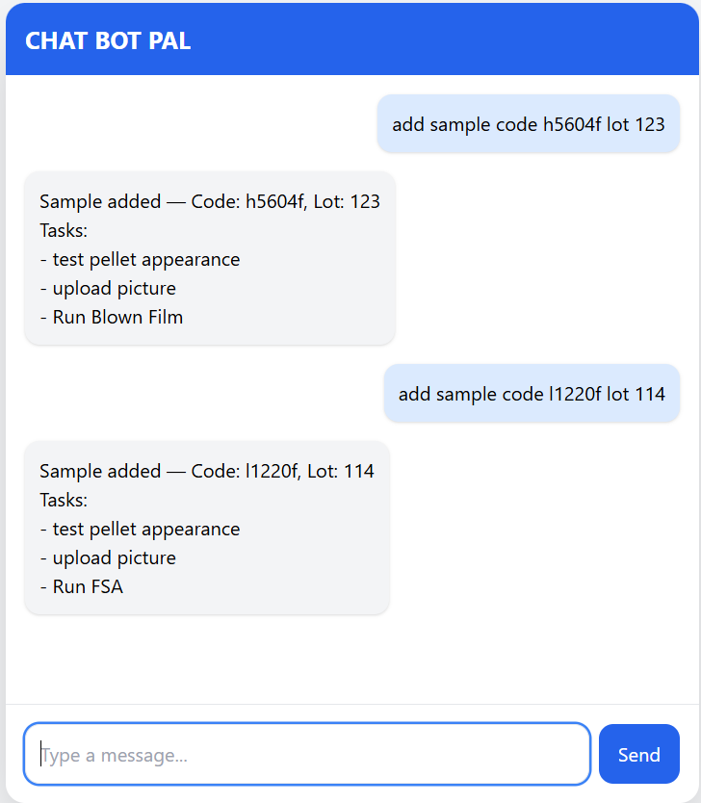
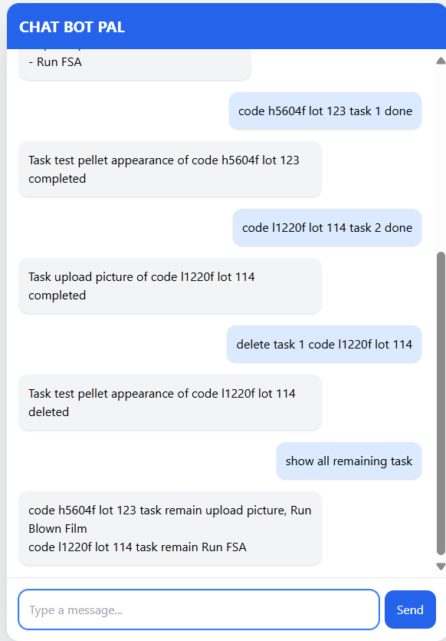
3. Finding the solutions
The chatbot supports many features for task management, such as adding sample, marking tasks as done, deleting tasks, deleting sample, showing remaining tasks, checking tasks of a template, marking sample as completed, and filtering completed and incomplete sample.

Slide 7
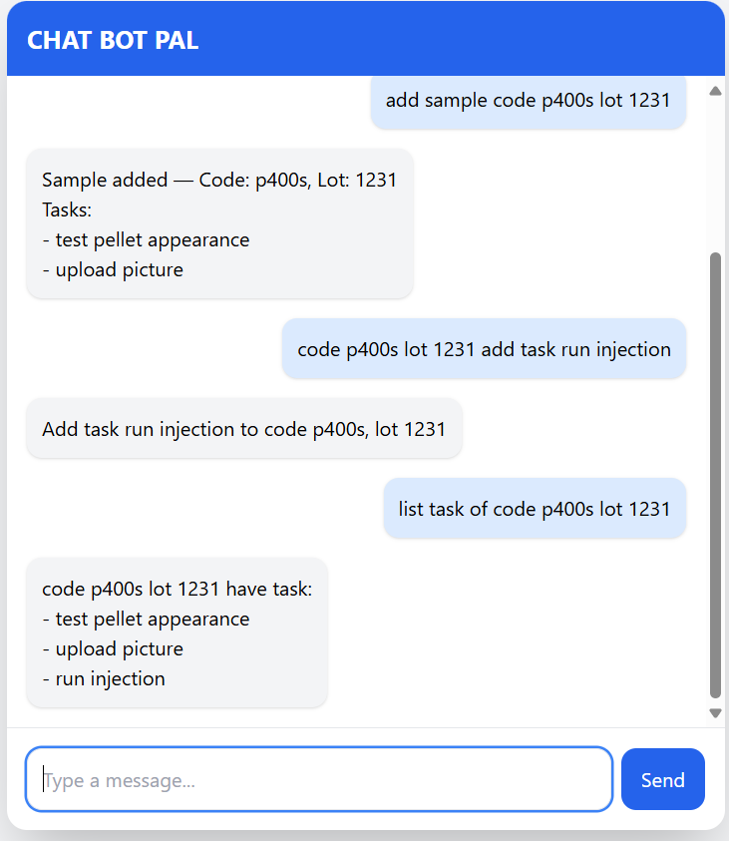
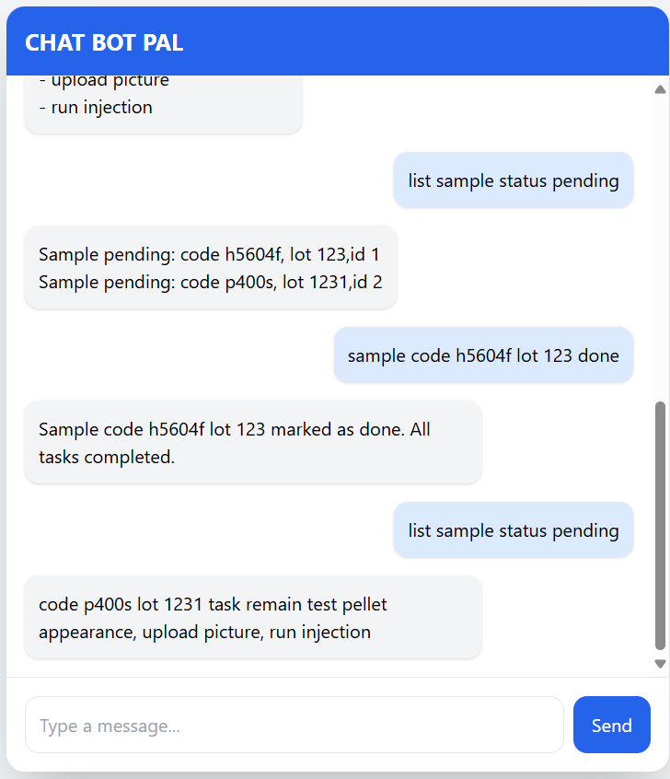
3. Finding the solutions
The key point is that the chatbot supports essential task management, allowing users to mark tasks to be done and easily retrieve unfinished tasks—all through simple message exchanges.

Slide 8
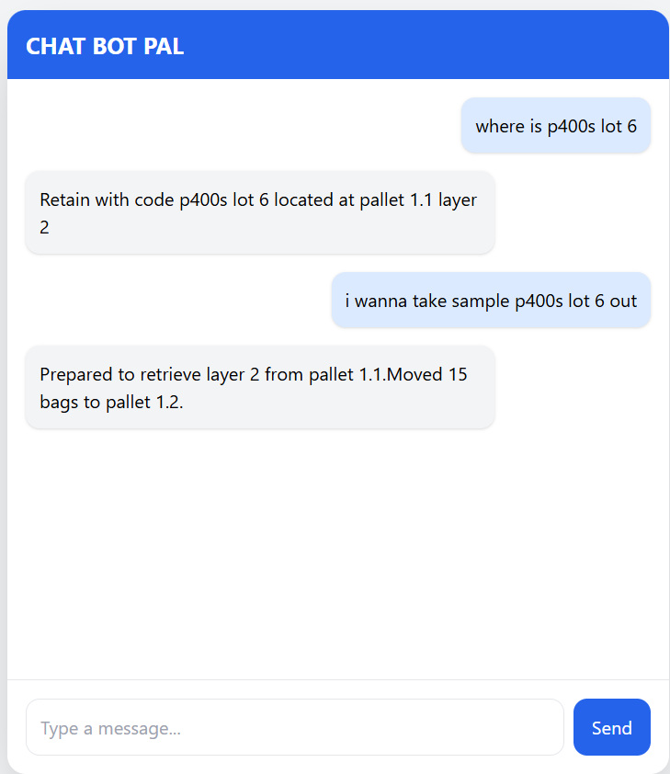
3. Finding the solutions
Another function of the chatbot is to help accurately retrieve the location of plastic retain bags in the warehouse and automatically update their positions when they are removed.

Slide 9
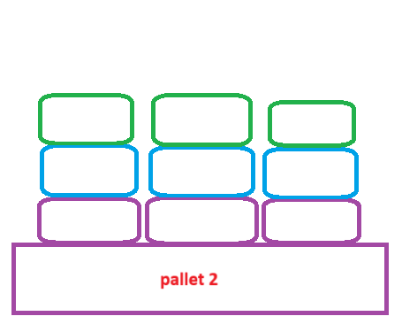
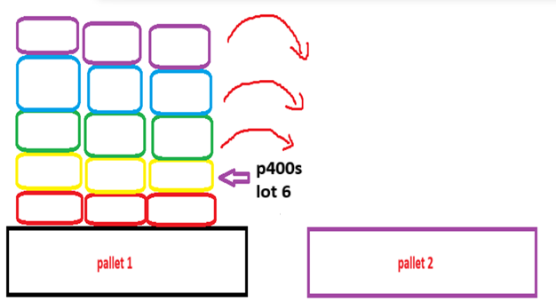
3. Finding the solutions
For example, when we want to retrieve a plastic bag located on pallet 1, layer 2, we need to move the upper layers to pallet 2. The relocated layers will be renumbered for both pallet and layer positions, and the software will automatically update the pallet and layer numbers in reverse order.

Slide 10
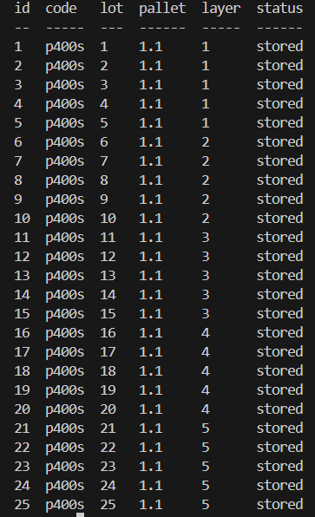
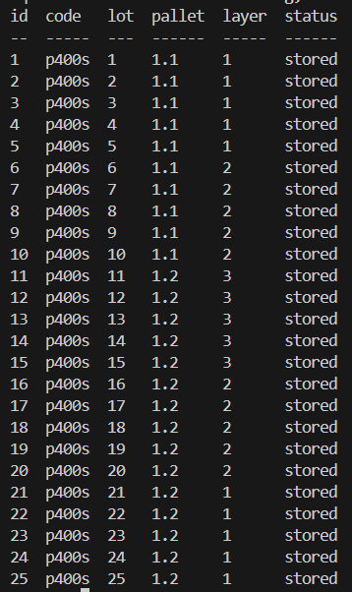
3. Finding the solutions
It can be seen that after the retrieval command, the data of the plastic bags in the database is accurately updated to reflect the actual situation with just a single operation, significantly reducing effort and time compared to the traditional method.

Slide 11
4. Evaluate the solutions
For example, to evaluate the effectiveness of the warehouse storage optimization at PAL, we can estimate as follows:
On average, plastic retrieval activities at PAL occur more than 15 times per month. Assuming 15 times as a baseline, each retrieval typically requires around 3 person working for approximately 1 hours or more. With an average labor cost of 60,000 VND per hour, 12 months per year, we can estimate the monthly labor loss associated with plastic retrieval activities. 15 X 3 X 1 X 60.000 X 12 = 32.400.000 VND per years

Slide 12
4. Evaluate the solutions
After implementing the chatbot, the time required for plastic retrieval has been reduced to only 30 minutes with just 2 personnel involved. We can make a preliminary estimation as follows:
15 X 2 X 0.5 X 60.000 X 12 = 10.800.000 VND per years
This results in an estimated cost saving of approximately:
32.400.000 – 10.800.000 = 21.600.000 VND per years

Slide 13
4. Evaluate the solutions
The cost of renting a server to run the chatbot is around 100,000 VND/month if using a free API key like gemini, so the estimated profit of the chatbot would be around
21.600.000 – 1.200.000 = 20.400.000 VND per years
With the task management function of the chatbot, it helps make work more efficient and reduces missed tasks compared to traditional methods. However, it's quite difficult to estimate the cost saving, so I will only calculate the hard saving for the plastic bag storage in the warehouse.

Slide 14
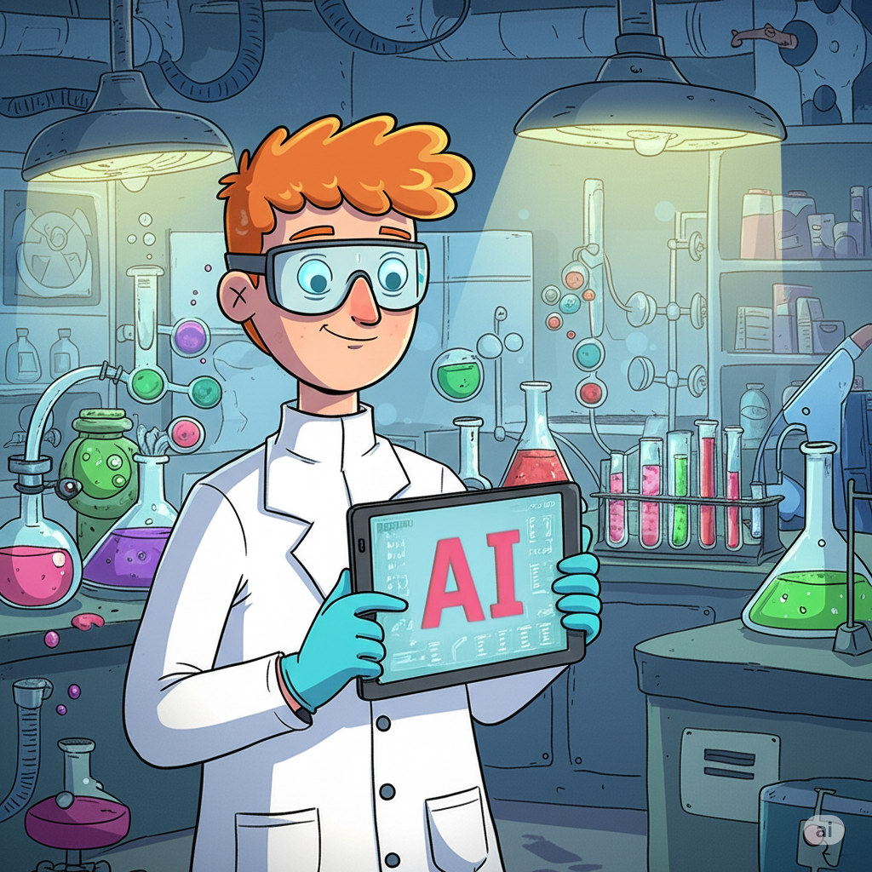
5. Conclusions and Future Directions
The last thing I would like to share is my desire to further develop this chatbot with more functions to help address various issues, replacing traditional paper-based methods. Another goal is to expand this chatbot assistant to other areas of the lab and potentially integrate machine learning models such as neural networks or XGBoost to predict measurement results that are correlated with each other, computer vision can be applied to automate certain manual test methods, such as pellet appearance inspection.

